Slide 1
Rename Tools
Nghi Yee
12/24/02

Slide 2
Agenda
Overview of the Rename jobs
- What does the jobs do?
- How to rename a user or group?
Scheduling the jobs
Troubleshooting
Q & A

Slide 3
Overview of Rename jobs
Rename a user or a group can only be done in Documentum Administrator
Can not change a user’s or a group’s name using the Set method
Can not rename the Docbase owner, installation owner, or yourself
(meaning that the person who is currently running this rename operation)
Schedule the job at night time
Notes:
The User Rename & Group Rename tools change a user’s or a group’s Docbase name. This job works in conjunction with Documentum Administrator. To change a user’s or a group name, you must connect to the Docbase using Documentum Administrator and make the change through the Users or Groups screen. Documentum Administrator gives you two
options for performing the change:
Execute the User Rename or Group Rename tool immediately after you save the change
Queue the change, to be performed at the next scheduled execution of User or Group Rename.
You cannot change a user’s or group’s name using the Set method. When a user’s name
changes, the change must be cascaded to many other objects that make use of it.
The User Rename tool generates a report that lists the objects changed by the
operation. The report is saved in the Docbase in
/System/Sysadmin/Reports/UserRename.
The User Rename tool is installed in the inactive state.
The User Rename tool has no arguments.

Slide 4
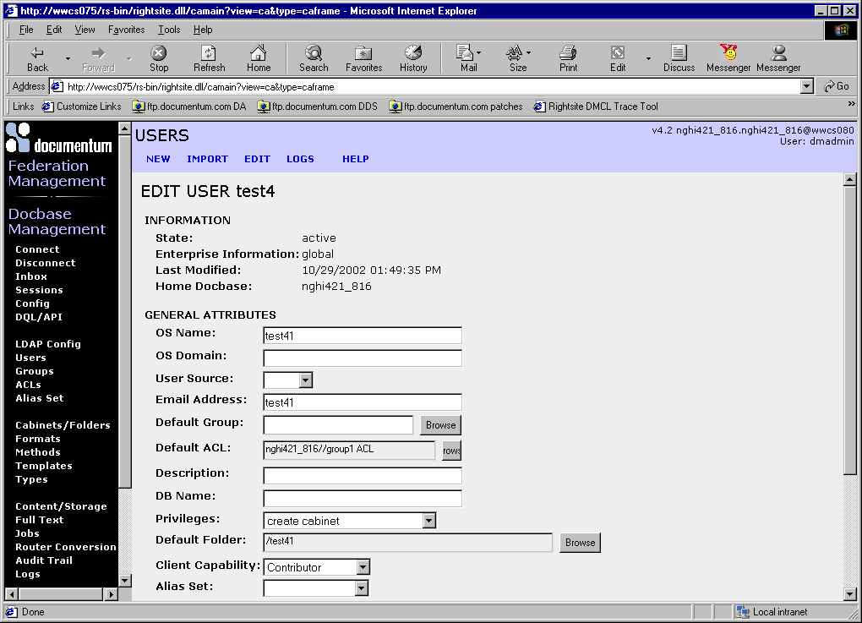
Do not rename a user from here
Notes:
Example of the User Rename screen

Slide 5
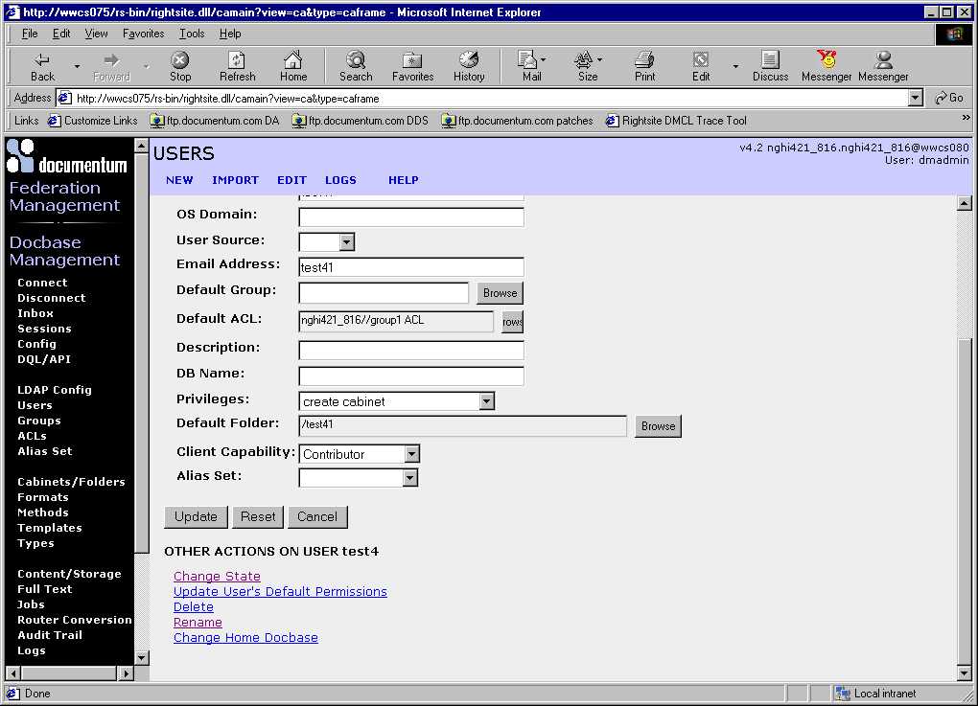
Click on the rename link
Notes:
Go to DA Users or Groups on left pane. Do not change the user’s name from the EDIT USER screen.
Click on Rename link on the bottom of the screen to Rename a user. Otherwise, the job will failed.

Slide 6

Values store in the UserRename object not in the dm_UserRename object
Notes:
This screen saves the attribute in the UserRename object not in the dm_UserRename object. Make sure to save the changes and unlock the checked out object are selected.

Slide 7
A dump of the dm_UserRename object
USER ATTRIBUTES
object_name : dm_UserRename
title : Docbase
subject : Rename Users
authors []: <none>
keywords []: <none>
resolution_label :
owner_name : nghiy
owner_permit : 7
group_name : docu
group_permit : 1
world_permit : 1
log_entry :
acl_domain : nghi421_816
acl_name : dm_acl_superusers

Slide 8
method_name : dm_UserRename
language_code :
method_arguments []: <none>
pass_standard_arguments : T
start_date : 09/21/2001 11:40:00 PM
expiration_date : 09/21/2009 11:40:00 PM
max_iterations : 0
run_interval : 1
run_mode : 3
is_inactive : T
inactivate_after_failure : F
target_server : nghi421_816.nghi421_816@wwcs080
method_trace_level : 0
run_now : F
method_data []: <none>

Slide 9
SYSTEM ATTRIBUTES
r_object_id : 0800686e80000202
r_object_type : dm_job
r_creation_date : 09/21/2001 12:54:23 PM
r_modify_date : 10/29/2002 01:49:48 PM
r_modifier : nghiy
r_access_date : nulldate
r_composite_id []: <none>
r_composite_label []: <none>
r_component_label []: <none>
r_order_no []: <none>
r_link_cnt : 0
r_link_high_cnt : 0
r_assembled_from_id : 0000000000000000
r_frzn_assembly_cnt : 0
r_has_frzn_assembly : F
r_is_virtual_doc : 0
r_page_cnt : 0
r_content_size : 0
r_lock_owner :
Notes:
NOTE: The r_object_id of the dm_UserRename & the r_object_id of the UserRename object are using the same tag # 08 which is dm_job object, but the r_object_type are different.

Slide 10
r_lock_date : nulldate
r_lock_machine :
r_version_label [0]: 1.0
[1]: CURRENT
r_immutable_flag : F
r_frozen_flag : F
r_has_events : F
r_creator_name : nghiy
r_is_public : F
r_policy_id : 0000000000000000
r_resume_state : 0
r_current_state : 0
r_alias_set_id : 0000000000000000
APPLICATION ATTRIBUTES
a_application_type :
a_status :
a_is_hidden : F
a_retention_date : nulldate
a_archive : F

Slide 11
a_compound_architecture :
a_link_resolved : F
a_content_type :
a_full_text : F
a_storage_type :
a_special_app :
a_effective_date []: <none>
a_expiration_date []: <none>
a_publish_formats []: <none>
a_effective_label []: <none>
a_effective_flag []: <none>
a_category :
a_continuation_interval : 0
a_next_continuation : nulldate
a_is_continued : F
a_last_invocation : 10/29/2002 01:49:22 PM
a_last_completion : 10/29/2002 01:49:47 PM
a_last_return_code : 0
a_last_process_id : 495
a_last_document_id : 0900686e80024ff1
a_iterations : 1

Slide 12
a_current_status : User Rename Completed At 10/29/2002
13:49:46
a_next_invocation : 10/29/2002 11:40:00 PM
INTERNAL ATTRIBUTES
i_is_deleted : F
i_reference_cnt : 1
i_has_folder : T
i_folder_id [0]: 0b00686e800001dc
i_contents_id : 0000000000000000
i_cabinet_id : 0c00686e80000105
i_antecedent_id : 0000000000000000
i_chronicle_id : 0800686e80000202
i_latest_flag : T
i_branch_cnt : 0
i_direct_dsc : F
i_is_reference : F
i_is_replica : F
i_vstamp : 9

Slide 13
A dump of the UserRename object
USER ATTRIBUTES
object_name : UserRename
title :
subject :
authors []: <none>
keywords []: <none>
resolution_label :
owner_name : dmadmin
owner_permit : 7
group_name :
group_permit : 5
world_permit : 3
log_entry :
acl_domain : dmadmin
acl_name : dm_4500686e80000500
language_code :
job_name : dm_UserRename
method_name : dm_UserRename
request_completed : T
priority : 1
Notes:
Job_name & method_name point to the dm_UserRename.

Slide 14
arguments_keys [0]: OldUserName
[1]: NewUserName
[2]: report_only
[3]: unlock_locked_obj
arguments_values [0]: test41
[1]: test4
[2]: F
[3]: T
SYSTEM ATTRIBUTES
r_object_id : 0800686e80024ff0
r_object_type : dm_job_request
r_creation_date : 10/29/2002 01:48:50 PM
r_modify_date : 10/29/2002 01:49:45 PM
r_modifier : nghiy
r_access_date : nulldate
Values coming from DA previous DA screenshot
Notes:
Notice the r_object_type is dm_job_request & r_object_id starts with 08 tag which is dm_job object

Slide 15
r_composite_id []: <none>
r_composite_label []: <none>
r_component_label []: <none>
r_order_no []: <none>
r_link_cnt : 0
r_link_high_cnt : 0
r_assembled_from_id : 0000000000000000
r_frzn_assembly_cnt : 0
r_has_frzn_assembly : F
r_is_virtual_doc : 0
r_page_cnt : 1
r_content_size : 3254
r_lock_owner :
r_lock_date : nulldate
r_lock_machine :
r_version_label [0]: 1.0
[1]: CURRENT
r_immutable_flag : F
r_frozen_flag : F
r_has_events : F
r_creator_name : dmadmin

Slide 16
r_is_public : T
r_policy_id : 0000000000000000
r_resume_state : 0
r_current_state : 0
r_alias_set_id : 0000000000000000
APPLICATION ATTRIBUTES
a_application_type :
a_status :
a_is_hidden : F
a_retention_date : nulldate
a_archive : F
a_compound_architecture :
a_link_resolved : F
a_content_type : text
a_full_text : T
a_storage_type : filestore_01
a_special_app :
a_effective_date []: <none>
a_expiration_date []: <none>

Slide 17
a_publish_formats []: <none>
a_effective_label []: <none>
a_effective_flag []: <none>
a_category :
INTERNAL ATTRIBUTES
i_is_deleted : F
i_reference_cnt : 1
i_has_folder : T
i_folder_id [0]: 0b00686e80024fef
i_contents_id : 0600686e800176d5
i_cabinet_id : 0c00686e80000105
i_antecedent_id : 0000000000000000
i_chronicle_id : 0800686e80024ff0
i_latest_flag : T
i_branch_cnt : 0
i_direct_dsc : F
i_is_reference : F
i_is_replica : F
i_vstamp : 2
Notes:
Same as GroupRename

Slide 18
Example of Job Report
Job: dm_UserRename
Report For DocBase nghi421_816.nghi421_816; As Of 10/29/2002 13:49:33
==============10/29/2002 1:49:34 PM===============
Renaming User 'test41' to 'test4' in docbase nghi421_816.nghi421_816
The following user rename options were specified:
Execution Mode: Save Changes
Checked out Objects: Unlock
====== Sysobjects locked by user 'test41' =====
(all the objects in this list will be unlocked)
**** Number of sysobjects affected: 0
Notes:
Example of the dm_UserRename job report

Slide 19
================== DM_USER OBJECT ================
-----------------------------------------------------
Object type : dm_user
Object id : 1100686e80001900
Name : test41
Attributes referencing user test41: user_name
Modified and saved the object
-----------------------------------------------------
===== ACL Objects referencing user test41 ====
-----------------------------------------------------
Object type : dm_acl
Object id : 4500686e80003500
Name : dm_4500686e80003500
Attributes referencing user test41: owner_name
Modified and saved the object
-----------------------------------------------------
**** Number of ACL objects affected: 1
===== Alias Set Objects referencing user test41 ====
Notes:
The dm_UserRename job rename all objects associated to that user.

Slide 20
**** Number of Alias Set objects affected: 0
====== Sysobjects referencing user 'test41', which are not locked =====
-----------------------------------------------------
Object type : dm_cabinet
Object id : 0c00686e80015105
Name : test41
Attributes referencing user test41: owner_name,acl_domain
Modified and saved the object
-----------------------------------------------------
**** Number of sysobjects affected: 1
====== Sysobject referencing user 'test41', which are locked =====
(all the objects in this list will be unlocked and modified)
**** Number of sysobjects affected: 0
====== Workflow and related objects referencing user test41. ======

Slide 21
====== Routers referencing user test41. ======
**** Number of router objects affected: 0
====== Activities referencing user test41. ======
**** Number of dm_activity objects affected: 0
====== Workflow objects referencing user test41. ======
**** Number of dm_workflow objects affected: 0
====== Workitem objects referencing user test41. ======
**** Number of dmi_workitem objects affected: 0
====== dmi_queue_item objects referencing user test41. ======
**** Number of dmi_queue_item objects affected: 0
====== Groups referencing user test41. ======
**** Number of group objects affected: 0

Slide 22
====== dmi_registry objects referencing user test41. ======
====== The following dm_registered objects have table_owner attribute
referencing user test41. The script will not update
the objects. You have to modify them manually.
====== The following dm_type objects have owner_name attribute
referencing user test41. The script will not update
the objects. You have to modify them manually.
====== The following dmi_type_info objects have acl_domain attribute
referencing user test41. The script will not update
the objects. You have to modify them manually.
--------10/29/2002 1:49:44 PM--------
----------------------------------------------
Report End; 10/29/2002 1:49:46 PM
Log Document ID : 0900686e80024ff4
Log Document Name: UserRename
Notes:
In eCS 4.1 dm_UserRename job doesn’t rename the workflow instance. The dm_UserRename job is failing when the user has Workflow tasks in his/her inbox. Due to bug # 32636 It has been fixed in the 4.2 version. The job report show all the options were saved where you rename a user from DA

Slide 23
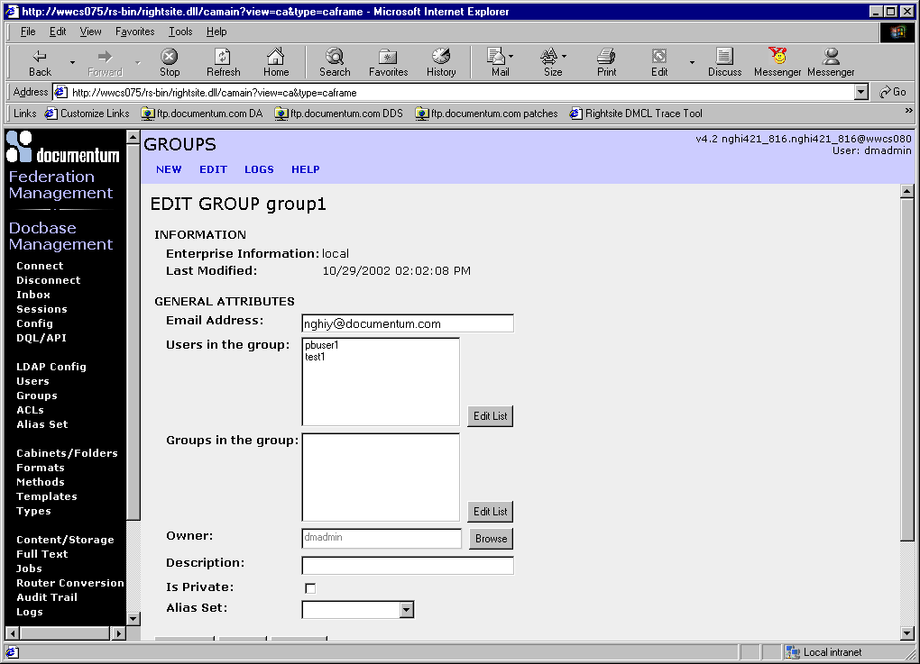
Example of the Group Rename

Slide 24
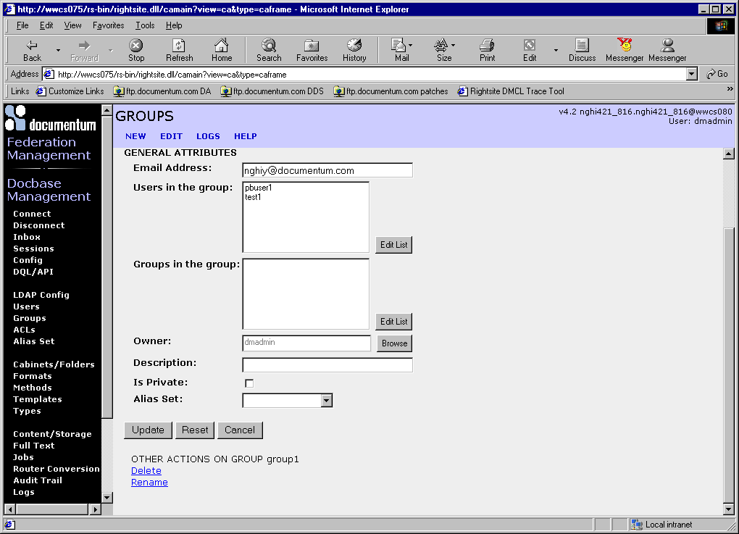
Continue
Click on the Rename link

Slide 25
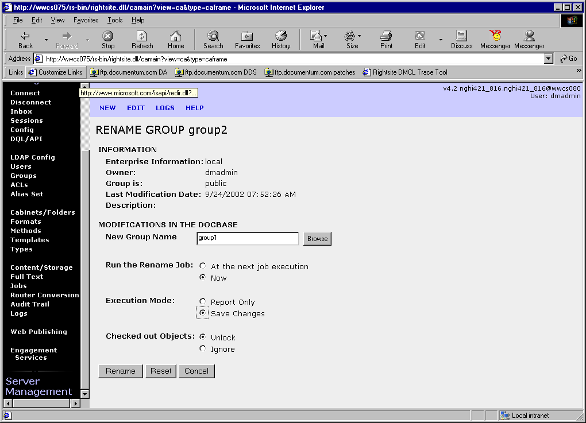
Example of the Group Rename
Values save in the GroupRename object not in dm_GroupRename object

Slide 26
Dump before rename a group
USER ATTRIBUTES
group_name : group1
group_address : nghiy@documentum.com
users_names [0]: test1
[1]: pbuser1
groups_names []: <none>
owner_name : dmadmin
is_private : F
description :
globally_managed : F
alias_set_id : 0000000000000000
SYSTEM ATTRIBUTES
r_object_id : 1200686e80001d00
r_modify_date : 10/29/2002 02:02:08 PM
INTERNAL ATTRIBUTES
i_all_users_names [0]: test1
[1]: pbuser1
i_is_replica : F
i_vstamp

Slide 27
Dump after rename a group
USER ATTRIBUTES
group_name : group2
group_address : nghiy@documentum.com
users_names [0]: test1
[1]: pbuser1
groups_names []: <none>
owner_name : dmadmin
is_private : F
description :
globally_managed : F
alias_set_id : 0000000000000000
SYSTEM ATTRIBUTES
r_object_id : 1200686e80002100
r_modify_date : 11/11/2002 07:47:07 AM
APPLICATION ATTRIBUTES
INTERNAL ATTRIBUTES
i_all_users_names [0]: test1
[1]: pbuser1
i_is_replica : F
i_vstamp : 0

Slide 28
Troubleshooting
Example of the error:
===== Connected to docbase cfrgcc.cfrgcc as user dmadmin. =====
Job: dm_UserRename
Report For DocBase cfrgcc.cfrgcc; As Of 3/1/2002 2:50:18 PM
FATAL: Could not update completion status of job request document 08005c718000dd28.
Error message from server:
[DM_SYSOBJECT_E_NO_WRITE_ACCESS]error: "No write access sysobject named 'UserRename'."
Notes:
Can you see what the problem here?

Slide 29
USER ATTRIBUTES
object_name : dm_UserRename
title : Docbase
subject : Rename Users
authors []: <none>
keywords []: <none>
resolution_label :
owner_name : dmadmin
owner_permit : 7
group_name : docu
group_permit : 1
world_permit : 1
log_entry :
acl_domain : qadc
acl_name : dm_acl_superusers
language_code :
method_name : dm_UserRename
method_arguments []: <none>
pass_standard_arguments : T
start_date : 5/9/01 11:40:00 PM
expiration_date : 5/9/09 11:40:00 PM
Notes:
Dump of customer’s dm_UserRename

Slide 30
USER ATTRIBUTES
object_name : UserRename
title :
subject :
authors []: <none>
keywords []: <none>
resolution_label :
owner_name : AdminJS
owner_permit : 1
group_name : admingroup
group_permit : 1
world_permit : 1
log_entry :
acl_domain : cfrgcc
Notes:
Dump of the UserRename object
The problem is that somehow the UserRename object permission got changed when the dm_UserRename job was run. The owner_permit should be 7 (delete) install of a 1 (no access)

Slide 31
Getting the following error in the job report:
Job: dm_UserRename
Report For DocBase EDM_HOME.EDM_HOME; As Of 10/9/2002 8:28:49 AM
==============10/9/2002 8:29:30 AM===============
Renaming User 'Hill, Kris' to 'Owen Kris' in docbase EDM_HOME.EDM_HOME
The following user rename options were specified:
Execution Mode: Save Changes
Checked out Objects: Ignore
WARNING: There are 50 sessions currently open. It is recommended that user rename is performed in single user connection mode.
================== DM_USER OBJECT ================
FATAL: Error: Could not find users Owen Kris or Hill, Kris. At least one of the users has to exist in the docbase.
Notes:
This error indicated that the job was running during business hours. The warning says that 50 sessions currently open. It is recommend to run off hours.

Slide 32
Any questions?
Anyone?
Thank you everyone

